Slide 1



INDIAN INSTITUTE OF TECHNOLOGY, KHARAGPUR
ELECTRONICS AND ELECTRICAL COMMUNICATION ENGINEERING DEPARTMENT
PROJECT PRESENTATION
TITLE
ECG Monitoring using Raspberry Pi Pico and Heart Sensor Module
GUIDE: Prof. Mrinal Kanthi Mandal
TEAM
Banda Raj Kishore
Himanshu Salunkhe
Shreyansh Gaykwad
Gunigari Nihith
Kondeti Harshini

Slide 2
Project Objective
Design and implement an ECG Monitoring System using Raspberry Pi Pico and MCP3208 ADC.
Key Features:
Real-time acquisition of ECG signals using biomedical electrodes.
Noise filtering and signal processing.
Visualization of ECG waveforms for analysis.
Provide a low-cost, portable solution for remote health monitoring.

Slide 3
Motivation
The project initially aimed to design a high-precision and efficient external ADC system for Raspberry Pi Pico to handle high-frequency signals.
While exploring ADC integration, the team identified the potential of using MCP3208 ADC for biomedical applications.
This led to the idea of developing an ECG monitoring system that combines signal acquisition, processing, and real-time visualization.

Slide 4
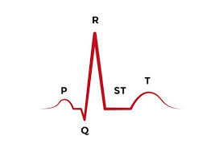
Concept
ECG Basics:
Records electrical activity of the heart.
Key components: P-wave, QRS complex, T-wave.
Importance:
Detect arrhythmias, heart attacks, and abnormalities.
Monitor treatment effectiveness.
Working Principle:
Signal acquisition → Amplification → Noise filtering → ADC → Visualization.

Slide 5
Apparatus
Hardware:
Raspberry Pi Pico (Microcontroller with SPI communication).
MCP3208 ADC (12-bit resolution for analog-to-digital conversion).
Electrodes (3-lead set), Breadboard, Jumper Wires, Resistors, Capacitors.
ECG module (AD8232)
Software:
MicroPython (Programming).
Thonny IDE (Code development).
Python with Matplotlib (Data visualization).

Slide 6
Methodology
Signal Acquisition: Electrodes capture heart signals; MCP3208 ADC converts them to digital values.
Analog-to-Digital Conversion: MCP3208 processes analog signals from electrodes with high resolution (12 bits).
Data Transmission: Data sent to Raspberry Pi Pico via SPI communication for real-time visualization.
Visualization: Python processes data and plots ECG waveforms using Thonny.

Slide 7
Participant | Contribution
Banda Raj Kishore | PCB layout and Machine Learning
Shreyansh | PCB layout design using DipTrace
Himanshu | Programming in MicroPython
Nihith | Hardware Assembly and Machine Learning
Harshini | Finding components and assembling hardware

Slide 8
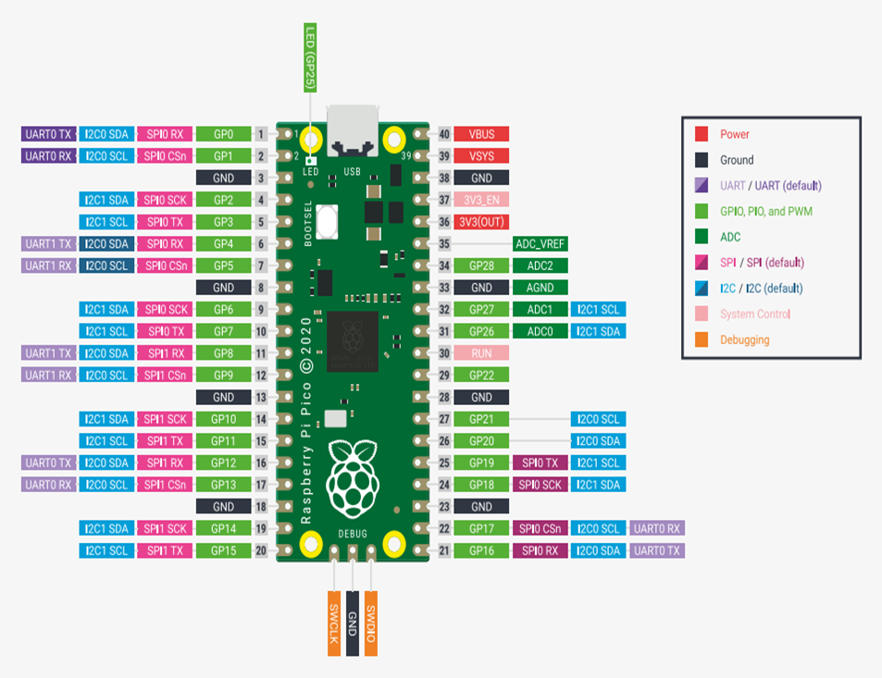
Hardware Components
The Raspberry Pi Pico is a low-cost, high-performance microcontroller board built around the RP2040 chip. It features a dual-core ARM Cortex-M0+ processor, 264kB of SRAM, and 2MB of flash memory2

Slide 9
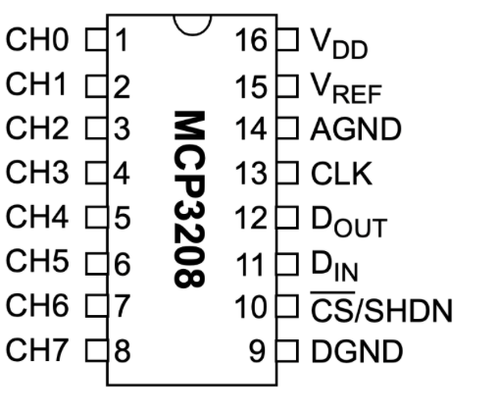
Hardware Components
MCP3208:
12-Bit Resolution: Ensures high precision in converting analog signals to digital values.
SPI Interface: Simplifies communication with microcontrollers like Raspberry Pi Pico.
Sample-and-Hold Circuitry: Maintains signal stability during conversion.
Wide Voltage Range: Operates between 2.7V and 5.5V, making it compatible with various power supplies310.

Slide 10
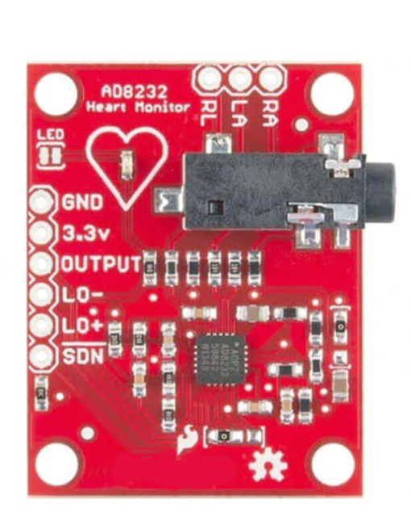
Hardware Components
Key Features
Integrated amplification and noise filtering.
pretty good noise rejection (CMRR: 80 dB for dc to 60 Hz).
Removes motion artifacts and high-frequency noise.
Low power consumption (170 μA typical).
Right Leg Drive (RLD) amplifier for improved common-mode rejection.
Compact size, ideal for portable devices.

Slide 11
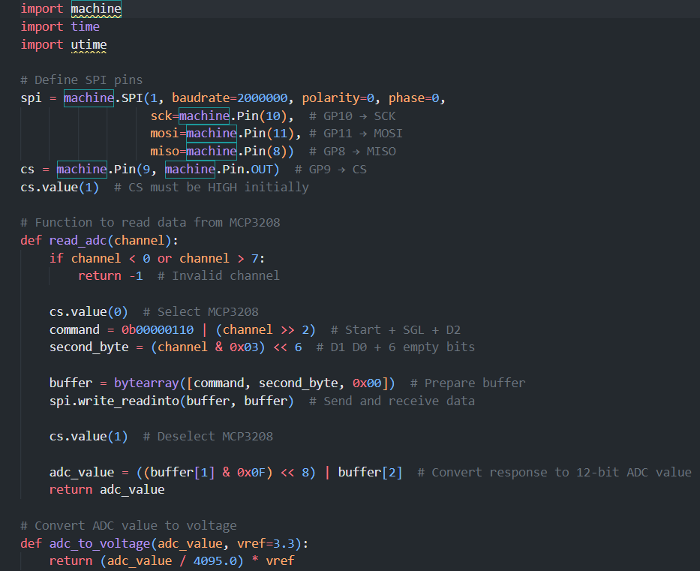
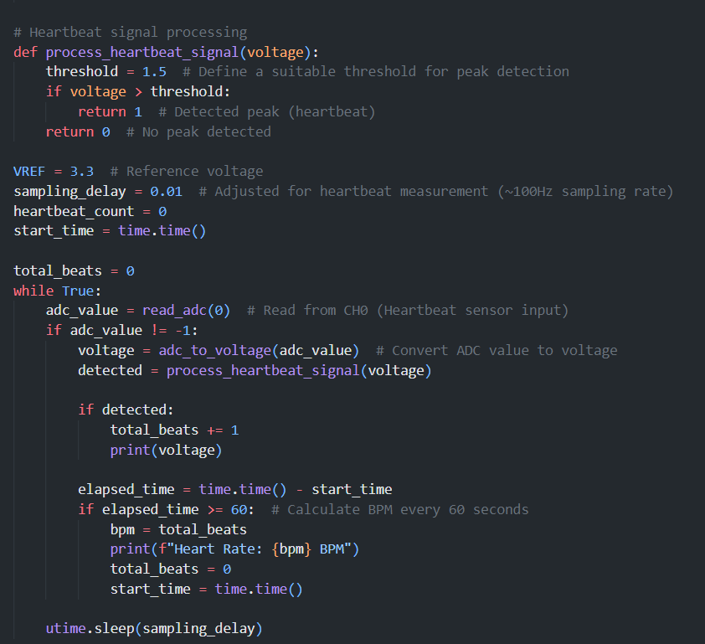
Code
*Original code can be varied due to usability (This is the base code for any usage)

Slide 12
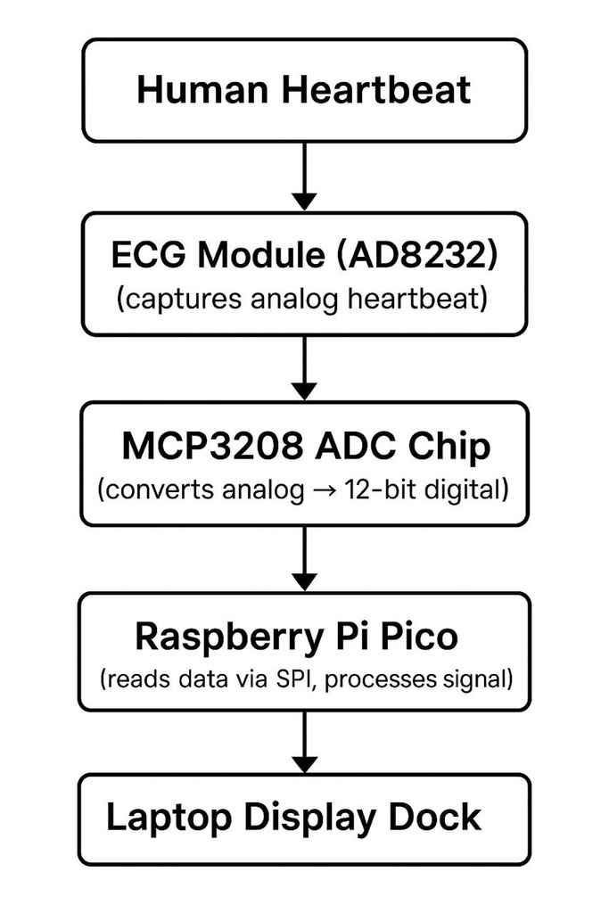
Simple Flow Chart and code view
SPI setup: Initializes communication with the MCP3208 ADC chip using the Raspberry Pi Pico’s SPI pins (GP8–GP11).
read_adc(channel): Sends a 3-byte SPI command to read analog data from the specified ADC channel (0–7).
Converts the returned 12-bit data to a usable value (adc_value from 0 to 4095).
adc_to_voltage(adc_value): Converts the raw ADC value to voltage
process_heartbeat_signal(voltage): Checks if the voltage crosses a threshold (1.2V) to detect a heartbeat.
Returns 1 if a heartbeat is detected, else 0.
Reads data continuously at around 100 samples per second.
When a peak is detected:
It checks if voltage is above 2V for confirmation.
Updates total beat count.
Calculates RR interval (time between current and previous heartbeat) using time.ticks_ms() (*This step is specifically written for testing later).

Slide 13
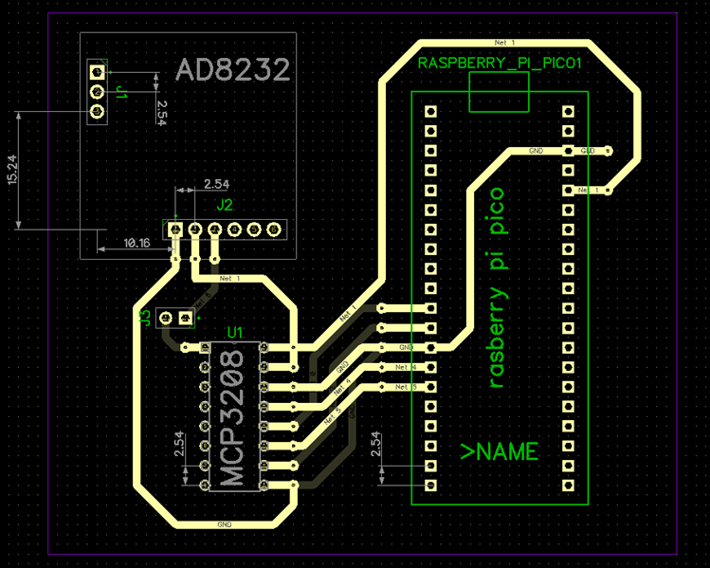
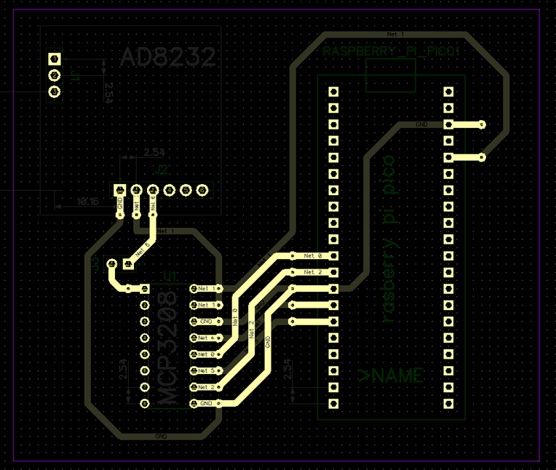
DipTrace Model
(Top)
(Bottom)

Slide 14
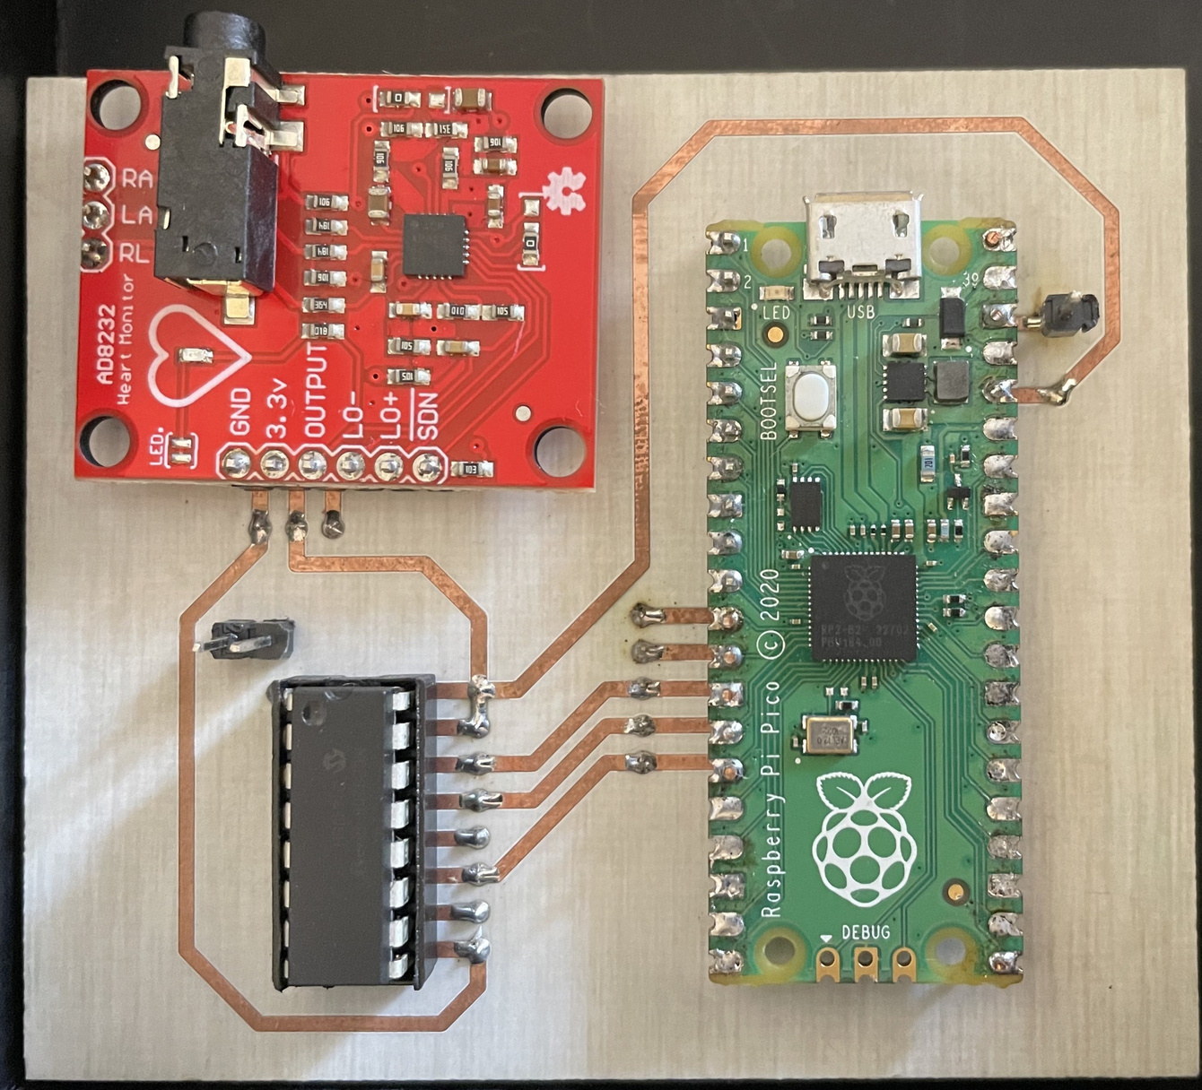
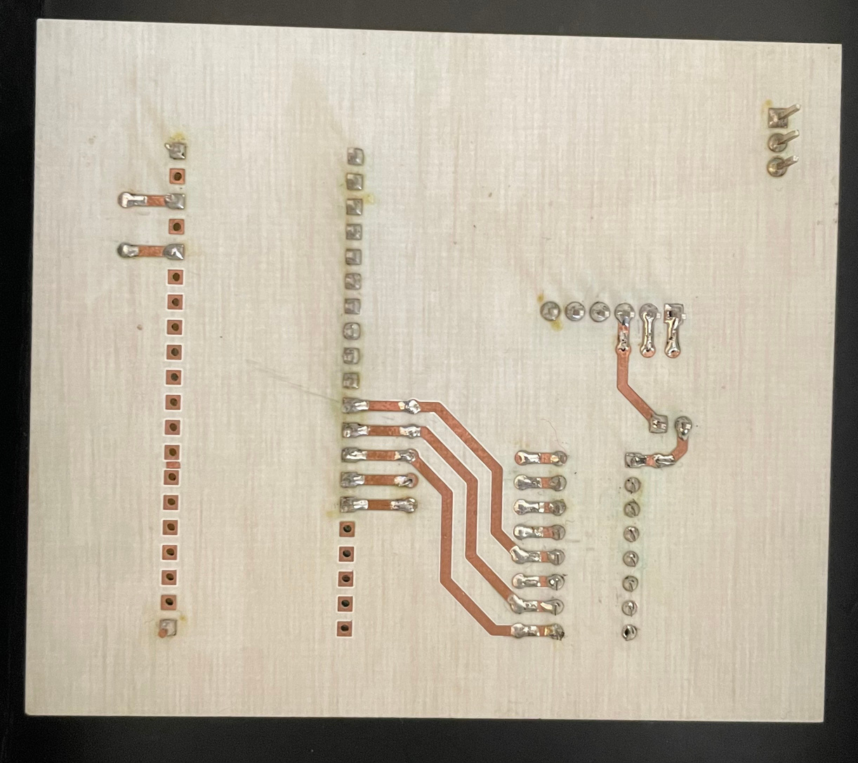
PCB
(Top)
(Bottom)

Slide 15
Machine learning Integration
Data Source: MIT-BIH ECG dataset
Features Extracted:
Mean RR, SDNN, RMSSD, NN50, pNN50
Model: Decision Tree (interpretable, lightweight)
Training: Done in Python with scikit-learn
Classes:
0: Normal heartbeat
1: Arrhythmia (PVC, APC, etc.)

Slide 16
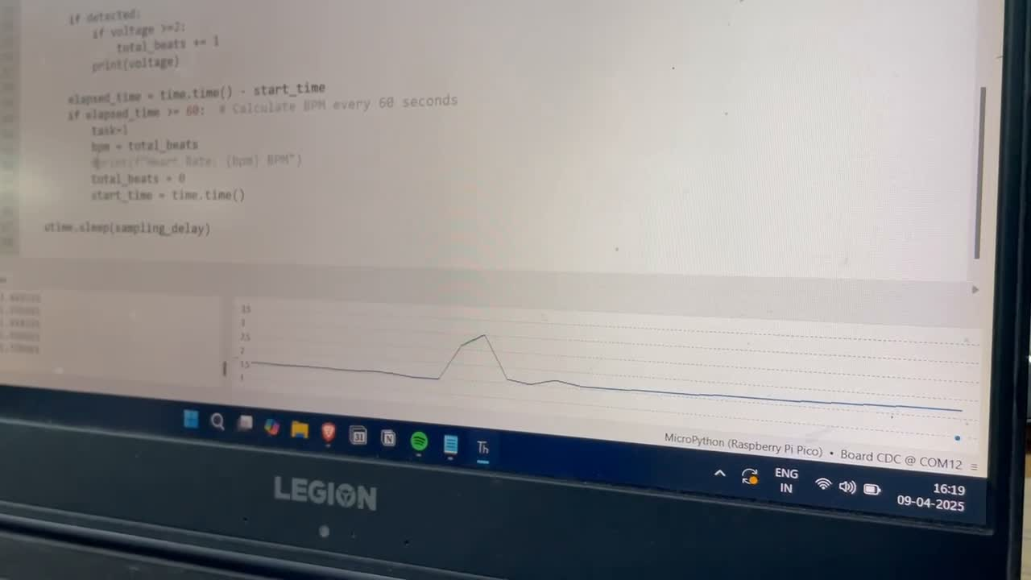
Demonstration Video

Slide 17
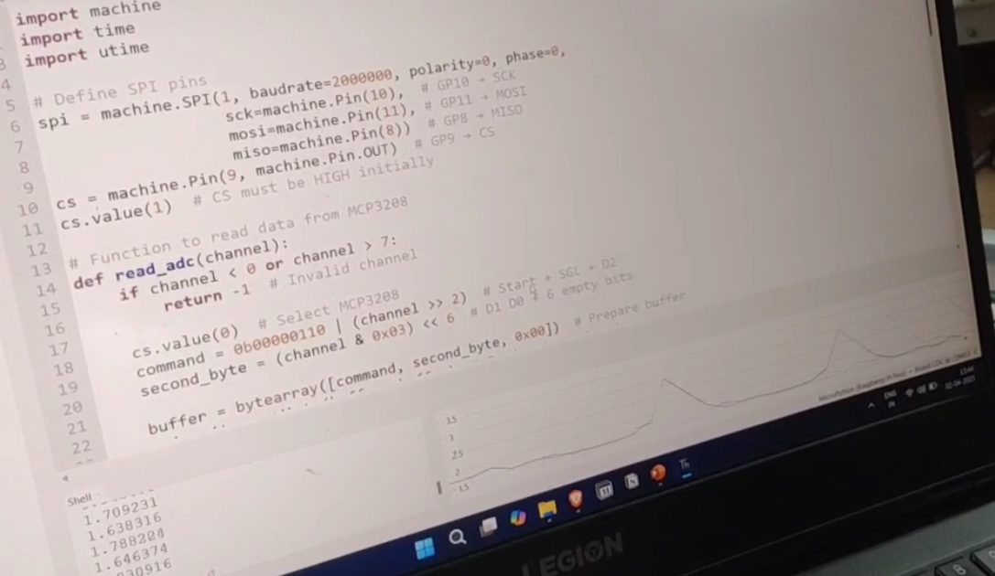

Slide 18
Trials and Errors
We put op-amp based filter (UA741 CP) to reduce the noise even more, But the power supply is an issue for this to implement. Further more the noise is highly comparable to the signal to eliminate with this basic filter.
We tried to raise the frequency limit, we tried to make it till 10Khz to detect velocity of objects, but failed due to ADC’s limitation.

Slide 19
Extension
We can put multiple sensors to the same chip and tweak the code a bit so that we can choose which sensor to work.
Since there is an external ADC that can successfully sample till 2KHz, we can also use this for moderate frequency tasks just by extending it’s other channel to our requirement and tweak the code
We can go over the budget a little and choose specific ADC for high frequency tasks as well. (Model can be made more efficient and multi purpose)
Since we have power of software with us, we can use software built filters to reduce noise.

Slide 20
Thank You

